Slide 1

Dealing with high-dimensional data
Projections, dimensionality reduction, and classification

Slide 2

Michael Murphy

Slide 3
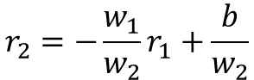
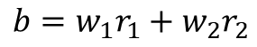
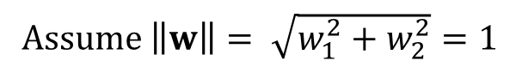
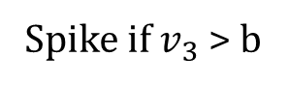
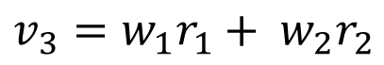
1
w₁
3
2
$$b=w_{1}r_{1}+w_{2}r_{2}$$
w₂
$$r_{2}=−\frac{w_{1}}{w_{2}}r_{1}+\frac{b}{w_{2}}$$
Decision boundary
Firing rate of neuron 2
$$v_{3}=w_{1}r_{1}+ {w_{2}r}_{2}$$
Spike if $v_{3}$ > b
Assume $\left\|w\right\|= \sqrt{w_{1}^{2}+w_{2}^{2}}=1$
Firing rate of neuron 1

Slide 4
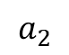
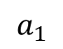
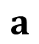
1
w₁
3
2
w₂
$$a_{2}$$
$$a$$
Firing rate of neuron 2
$$v_{3}=w_{1}r_{1}+ {w_{2}r}_{2}$$
Spike if $v_{3}$ > b
Assume $\left\|w\right\|= \sqrt{w_{1}^{2}+w_{2}^{2}}=1$
$$a_{1}$$
Firing rate of neuron 1

Slide 5
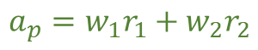
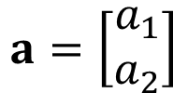
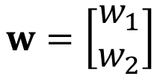
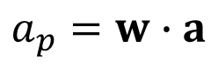
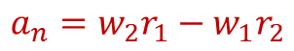
1
w₁
3
2
w₂
$$a$$
$$a_{n}=w_{2}r_{1}−w_{1}r_{2}$$
Firing rate of neuron 2
$$v_{3}=w_{1}r_{1}+ {w_{2}r}_{2}$$
Spike if $v_{3}$ > b
Assume $\left\|w\right\|= \sqrt{w_{1}^{2}+w_{2}^{2}}=1$
$$a_{p}=w_{1}r_{1}+w_{2}r_{2}$$
$$w=\left[\begin{matrix}w_{1} \\ w_{2}\end{matrix}\right]$$
$$a=\left[\begin{matrix}a_{1} \\ a_{2}\end{matrix}\right]$$
Firing rate of neuron 1
$$a_{p}=w∙a$$

Slide 6
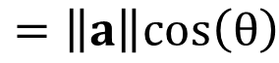
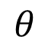
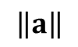
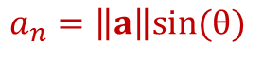
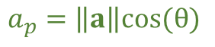
1
w₁
3
2
w₂
$$a$$
$$a_{n}=\left\|a\right\|sin(θ)$$
Firing rate of neuron 2
$$\left\|a\right\|$$
$$v_{3}=w_{1}r_{1}+ {w_{2}r}_{2}$$
Spike if $v_{3}$ > b
Assume $\left\|w\right\|= \sqrt{w_{1}^{2}+w_{2}^{2}}=1$
$$θ$$
$$a_{p}=\left\|a\right\|cos(θ)$$
$$w=\left[\begin{matrix}w_{1} \\ w_{2}\end{matrix}\right]$$
$$a=\left[\begin{matrix}a_{1} \\ a_{2}\end{matrix}\right]$$
Firing rate of neuron 1
$$a_{p}=w∙a$$
$$=\left\|a\right\|cos\left(θ\right)$$

Slide 7
Projections in neuroscience

Slide 8
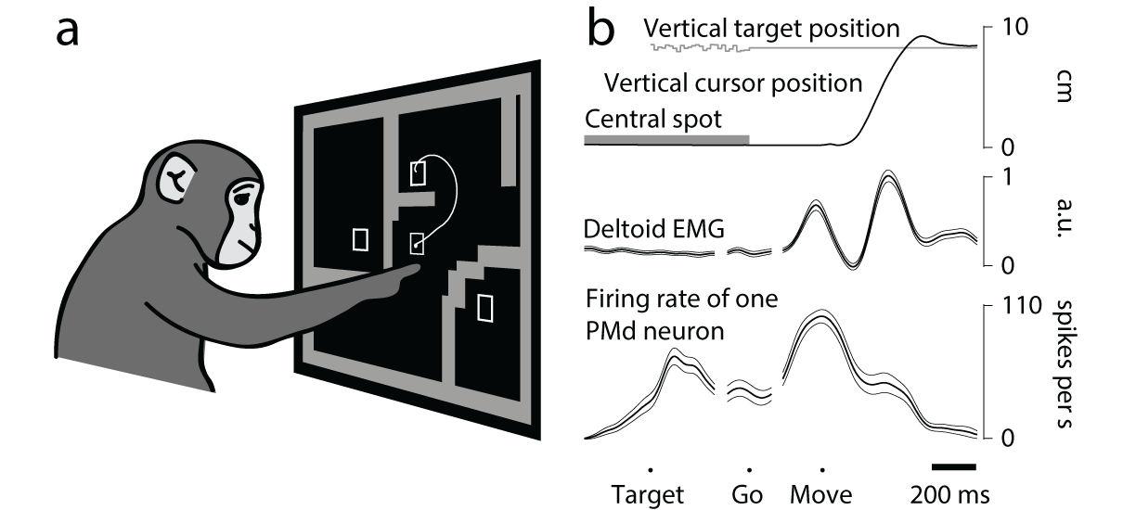
How can we plan a course of action, while still waiting for the right moment to act?
Premotor
Cortex
(PMd)
Primary motor cortex
(M1)
Spinal cord
Muscles

Slide 9
How can we plan a course of action, while still waiting for the right moment to act?
Premotor
Cortex
(PMd)
Primary motor cortex
(M1)
Spinal cord
Muscles
Activity during
movement:
high
high
high
high
Activity during
planning:
high
medium
low
~none
Threshold?
Inhibitory gating?

Slide 10
How can we plan a course of action, while still waiting for the right moment to act?
Premotor
Cortex
(PMd)
Primary motor cortex
(M1)
Spinal cord
Muscles
Threshold?
Inhibitory gating?

Slide 11
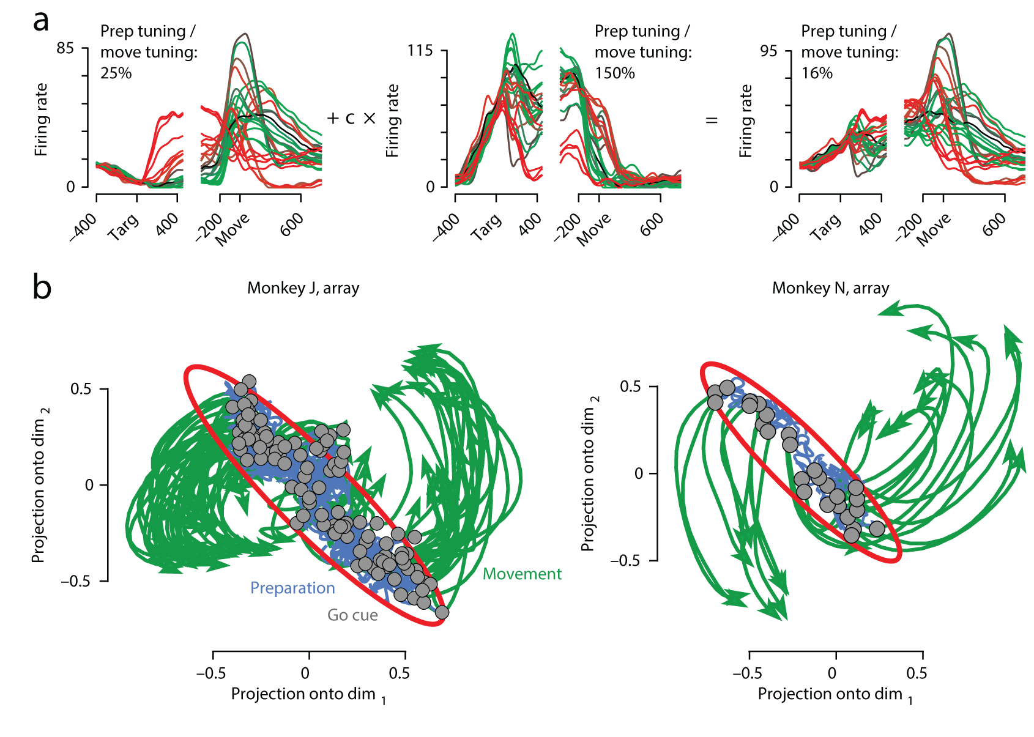
Churchland et al 2012

Slide 12
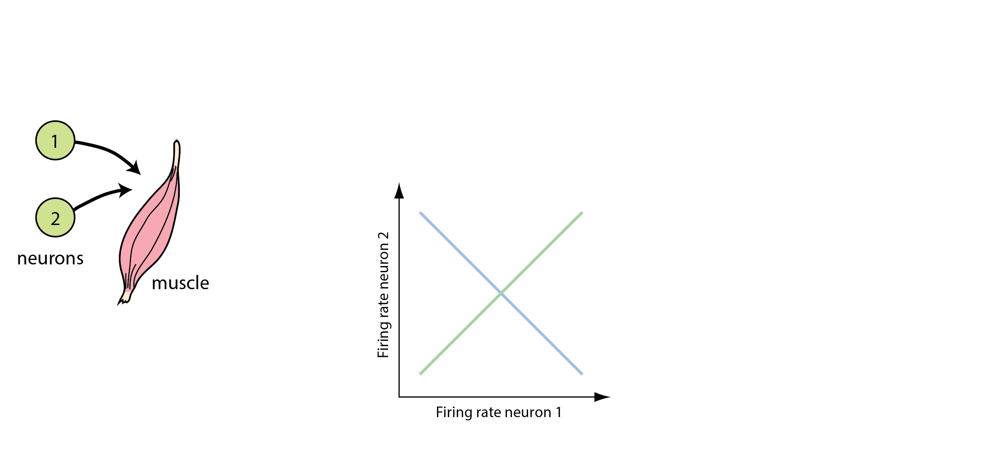

Slide 13
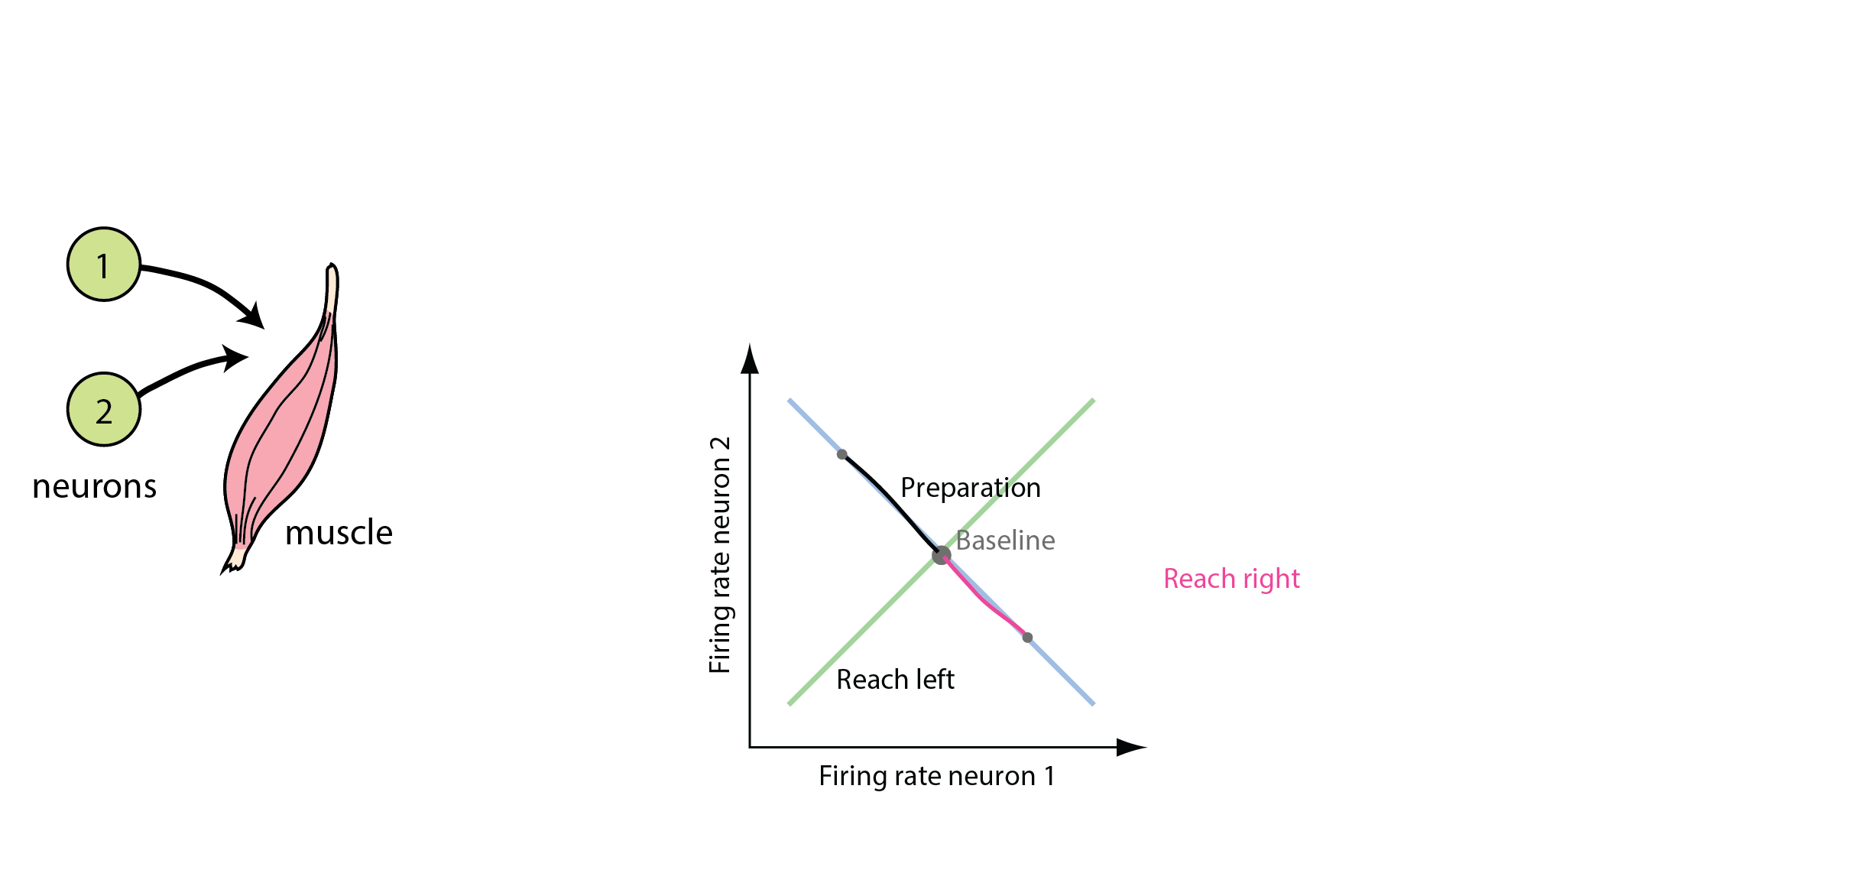
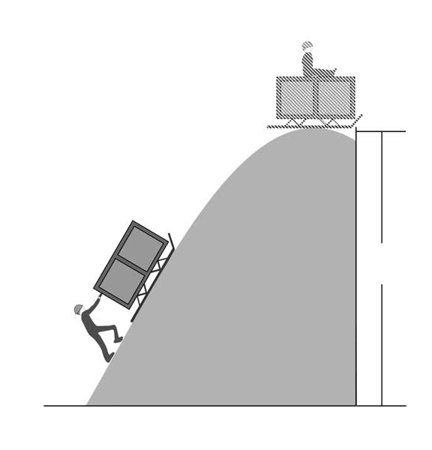
preparatory
activity

Slide 14
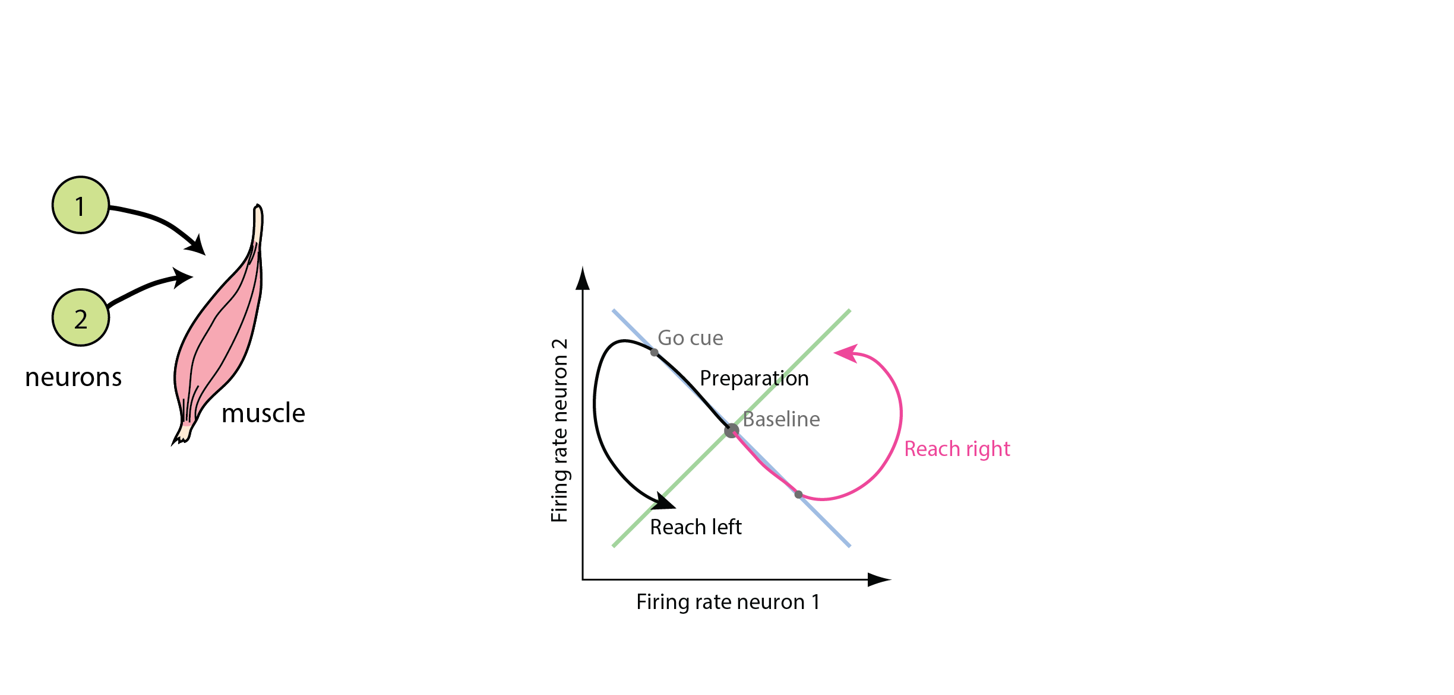
preparatory
activity

Slide 15
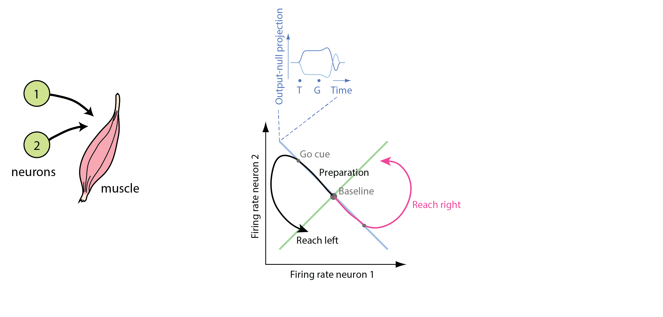
preparatory
activity

Slide 16
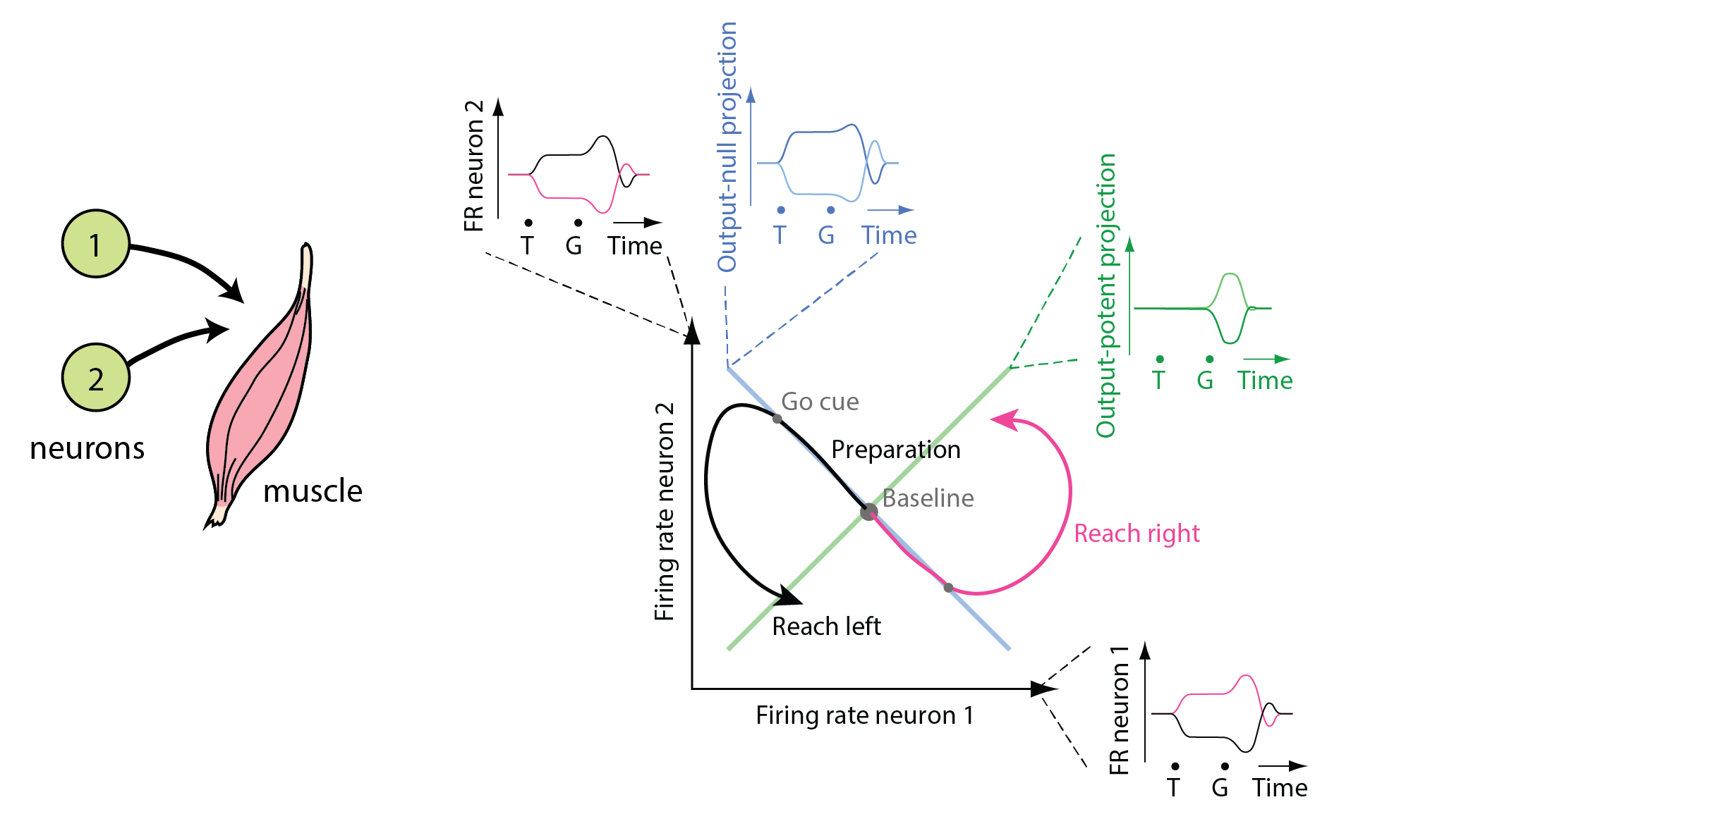
preparatory
activity
Only activity in output-potent directions affects muscles
Neural firing rates are a combination of activity in output-potent and output-null directions
There are more neurons than muscles, so there will always be output-null dimensions (assuming not all neurons do the same thing)

Slide 17
Dimensionality reduction and classification

Slide 18
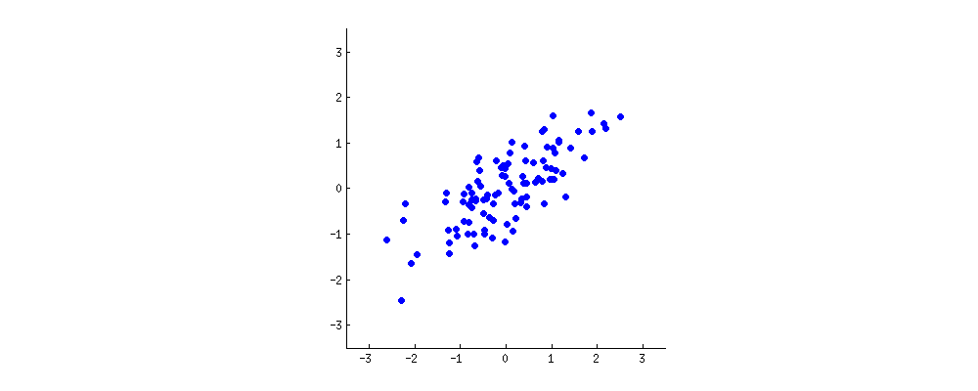
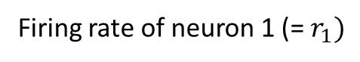
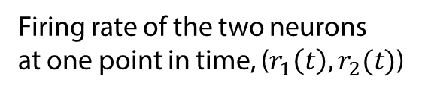
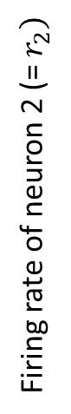
How do we summarize what this population of neurons is doing?
Cov($r_{i}$, $r_{j}$): $Covariance of neuron i and neuron j over time=σ_{ij}^{2}= \left\langle \left(r_{i}−μ_{i}\right)\left(r_{j}−μ_{j}\right)\right\rangle$
Firing rate of the two neurons
at one point in time, ($r_{1}\left(t\right),r_{2}(t)$)
Firing rate of neuron 2 (= $r_{2})$
Firing rate of neuron 1 (= $r_{1})$

Slide 19
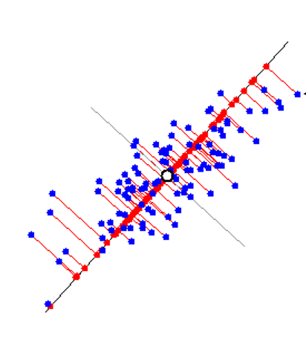
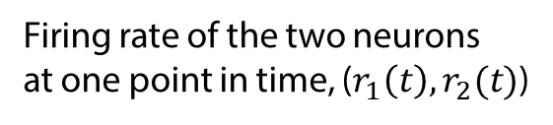
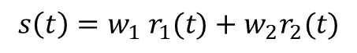
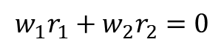
We want “summarize” what the two neurons are doing without losing much information
Original data
1-dimensional “summary”
$$s\left(t\right)=w_{1}{ r}_{1}(t)+w_{2}r_{2}(t)$$
Firing rate of the two neurons
at one point in time, ($r_{1}\left(t\right),r_{2}(t)$)
Firing rate of neuron 2 (= $r_{2})$
$$w_{1}r_{1}+w_{2}r_{2}=0$$
Firing rate of neuron 1 (= $r_{1})$

Slide 20

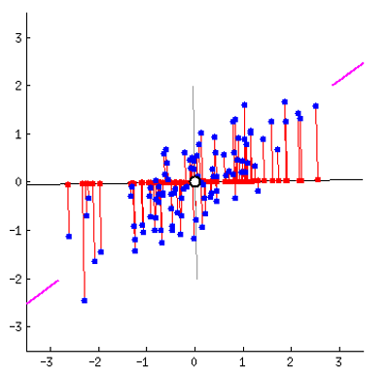
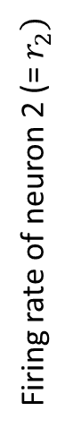
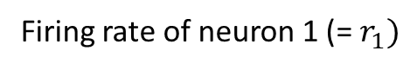
Different bases produce different 1d summaries (representations) of the data
Original data
1-dimensional “summary”
Firing rate of neuron 2 (= $r_{2})$
Firing rate of neuron 1 (= $r_{1})$

Slide 21
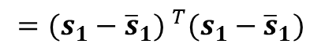
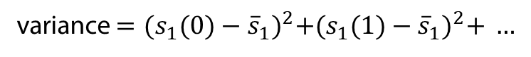
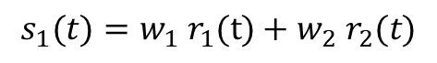
Which basis to pick? The one that maximizes variance of projected data
Original data
1-dimensional “summary”
$$s_{1}(t)=w_{1}{ r}_{1}(t)+w_{2}{ r}_{2}(t)$$
variance $={(s_{1}(0)−{\overline{s}}_{1})}^{2}+{(s_{1}(1)−{\overline{s}}_{1})}^{2}+ …$
Firing rate of neuron 2 (= $r_{2})$
$$={(s_{1}−{\overline{s}}_{1}) }^{T}(s_{1}−{\overline{s}}_{1})$$
Firing rate of neuron 1 (= $r_{1})$
This is also the dimension that minimizes the mean squared error (sum of the red lines)

Slide 22
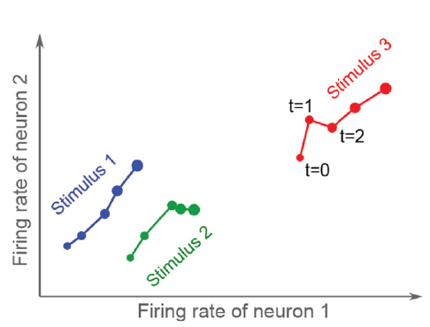
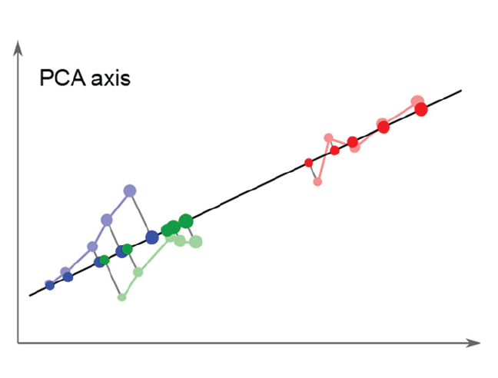
PCA preserves information about the neural activity, but not about the stimulus
first PCA axis

Slide 23
PCA preserves information about the neural activity, but not about the stimulus
Trajectory along
first PC axis
first PCA axis
time

Slide 24
PCA preserves information about the neural activity, but not about the stimulus
Trajectory along
first PC axis
Trajectory along
second PC axis
first PCA axis
second PCA axis
time
time

Slide 25
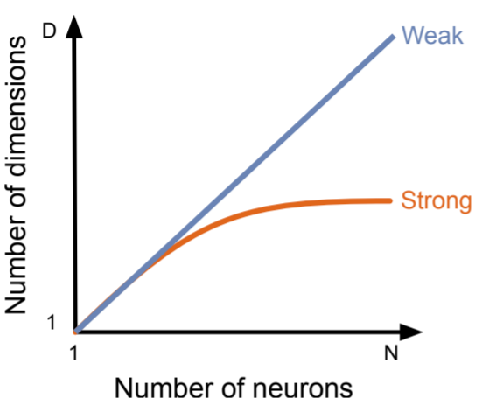
Mark D. Humphries (2020) Strong and weak principles of neural dimension reduction
The weak principle: dimensionality reduction is a convenient tool for making sense of complex neural data.
The strong principle: dimensionality reduction shows us how neural circuits actually operate and compute.

Slide 26
The same thing from a different perspective
Rather than projecting observed data into a low-dimensional space (eg with PCA), we want to construct a hypothesis about how the observed data was generated.
Eg: the observed data (spikes) are noisy observations of a small number of underlying latent variables.

Slide 27
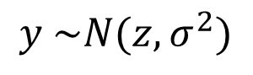
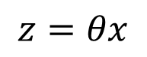
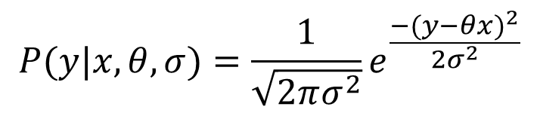
Recall from Bayesian inference
spikes (known)
Predicted spike
distribution
$$P(y|x,θ,σ)=\frac{1}{\sqrt{2πσ^{2}}}e^{\frac{−{(y−θx)}^{2}}{2σ^{2}}}$$
$$y \sim N(z,σ^{2})$$
model
parameters
(unknown)
Underlying
Spike rate
$$z=θx$$
Now, find the “most likely” $θ$ given observed y and x!
stimulus feature (known)
Stimulus feature (x)
Recorded spikes (y)
Encoding model
P ( y | x )
time →
time →

Slide 28
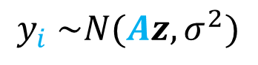
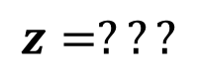
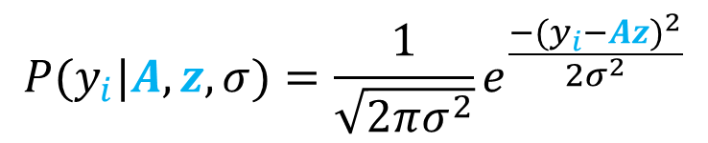
Now we are instead trying to do the following:
spikes (known)
Predicted spike
distribution
$$P(y_{i}|A,z,σ)=\frac{1}{\sqrt{2πσ^{2}}}e^{\frac{−{(y_{i}−Az)}^{2}}{2σ^{2}}}$$
$$y_{i} \sim N(Az,σ^{2})$$
model
parameters
(unknown)
Latent
Variable(s)
$$z=???$$
Now, find the “most likely” $θ$ given observed y and x!
latent variable(s)
(also unknown)
Latent variable (z)
Recorded spikes (y_{i})
Encoding model
P ( y | z )
time →
time →

Slide 29
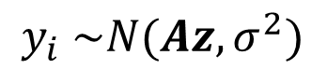


The Expectation Maximization algorithm converges to a local solution
spikes (known)
Predicted spike
distribution
$$P(y_{i}|A,z,σ)=\frac{1}{\sqrt{2πσ^{2}}}e^{\frac{−{(y_{i}−Az)}^{2}}{2σ^{2}}}$$
$$y_{i} \sim N(Az,σ^{2})$$
model
parameters
(unknown)
Latent
Variable(s)
$$z=???$$
Initialization: make a random guess for model parameters (here A and $σ$).
Expectation step: compute the expected value of Z given y, A, and $σ$.
Maximization step: re-estimate A and $σ$ given y and our new estimate of Z.
Iterate steps 2-3 until converged.

Slide 30






A generative modeling take on dimensionality reduction
We observe the spiking of a population of N neurons, $y(t)=\left\{y_{1}(t),y_{2}(t),…y_{N}(t)\right\}$.
A simple model might be to assume that the firing rate of each neuron $y_{n}$ is a function of a small number D (D<<N) of latent variables, $z$, as follows:
$$z_{d}\left(t\right) \sim N(0,1)$$
$$y_{n}\left(t\right) \sim N( \sum_{d=1}^{D}{W_{n,d}}z_{d}(t),σ^{2})$$
Or, in matrix notation,
Identity matrix
z$\left(t\right) \sim N(0,I)$
y$\left(t\right) \sim N(W∙z(t),σ^{2}I)$
“factor loading” matrix (D x N)
Or written another way:
y$\left(t\right)= W∙z\left(t\right)+ε, ε\sim N(0,σ^{2}I)$
This is “Probabilistic PCA”!

Slide 31










We can create lots of models within this same generative framework
Probabilistic PCA:
z$\left(t\right) \sim N(0,I)$
y$\left(t\right)= W∙z\left(t\right)+ε, ε\sim N(0,σ^{2}I)$
Factor Analysis:
z$\left(t\right) \sim N(0,I)$
$$Ψ =\left[\begin{matrix}σ_{1}^{2} & 0 & … 0 \\ 0 & σ_{2}^{2} & … 0 \\ \begin{aligned}⋮ \\ 0\end{aligned} & \begin{aligned}⋮ \\ 0\end{aligned} & \begin{aligned}⋱ ⋮ \\ {… σ}_{N}^{2}\end{aligned}\end{matrix} \right]$$
y$\left(t\right)= W∙z\left(t\right)+ε, ε\sim N(0,Ψ)$
Linear Dynamical System:
z$\left(t\right)=A∙z\left(t−1\right)+v, v\sim N(μ,{σ^{2}I}_{z})$
y$\left(t\right)=W∙z\left(t\right)+b+ε, ε\sim N(0, {σ^{2}I}_{x})$
Gaussian Process Factor Analysis:
$$z_{i}\left(t\right) \sim N(0,K_{i})$$
y$\left(t\right)=W∙z\left(t\right)+b+ε, ε\sim N(0,Ψ)$

Slide 32







…LOTS of models
Hidden Markov Model:
z$\left(t\right)∈\{1,2,…D\}$ (discrete states!)
y$\left(t\right) \sim N(μ_{z},Σ_{z})$
Independent Component Analysis:
z$\left(t\right) \sim maximally non−Gaussian$
y$\left(t\right) \sim N(z,σ_{z}^{2} I)$
Switching Linear Dynamical System:
$$π\left(t\right)=∈\{1,2,…D\}$$
z$\left(t\right)=A∙z\left(t−1\right)+v, v\sim N(μ_{π},{σ_{π}^{2}I}_{z})$
y$\left(t\right)=W∙z\left(t\right)+b+ε, ε\sim N(0, {σ^{2}I}_{x})$

Slide 33
Roweis and Ghahramani (1999) A unifying review of linear Gaussian models
“Factor analysis, principal component analysis, mixtures of gaussian clusters, vector quantization, Kalman filter models, and hidden Markov models can all be unified as variations of unsupervised learning under a single basis generative model.
Through the use of other nonlinearities, we show how independent component analysis is also a variation of the same basic generative model.

Slide 34
PCA preserves information about the neural activity, but not about the stimulus
What if we pick a different axis?
Principal component analysis
Classification
first PCA axis

Slide 35

An example decoder: Fisher’s linear discriminant analysis
Linear discriminant analysis finds a representation that makes it easy to distinguish the different stimulus conditions. To do so, it discards variance that doesn’t help us distinguish between experimental conditions.

Slide 36

Fisher’s Linear Discriminant Analysis
R1 = m * R2 + b
R1 > m * R2 + b → stimulus 1
Presynaptic
neurons
R1
w1
…
Postsynaptic
neuron
Spike if:
w1 * R1 + w2 * R2 + … + w5 * R5 > b
w5
R5

Slide 37










Fisher’s Linear Discriminant Analysis
Goal: find w’s to maximize separability (S):
$$S=\frac{distance between projected class means}{variance within each projected class}$$
y
$$μ_{1}$$
$$S=\frac{{(w∙μ_{1}−w∙μ_{2})}^{2}}{variance within each projected class?}$$
$$variance of projection={\left(w∙r_{1}−w∙μ_{1}\right) }^{2}$$
$$={\left(w∙\left(r_{1}−μ_{1}\right)\right) }^{2}$$
$$μ_{2}$$
$$=w∙Σ_{1}∙w^{T}$$
$$S=\frac{{(w∙μ_{1}−w∙μ_{2})}^{2}}{w∙Σ_{1}∙w^{T}+w∙Σ_{2}∙w^{T}}$$
x
$$w \sim {\left(Σ_{1}+Σ_{2}\right)}^{−1}\left(μ_{1}−μ_{2}\right)$$
$$p=w_{x}r_{x}+w_{y}r_{y}$$
$=w∙r$
$$c=w∙\frac{1}{2} (μ_{1}+μ_{2})$$

Slide 38




Fisher’s Linear Discriminant Analysis
Goal: find w’s to maximize separability (S):
y
$$separability=\frac{{(w∙μ_{1}−w∙μ_{2})}^{2}}{w∙Σ_{1}∙w^{T}+w∙Σ_{2}∙w^{T}}$$
$$μ_{1}$$
$$p=w_{x}r_{x}+w_{y}r_{y}$$
$=w∙r$
Weights that maximize separability
$$w \sim {\left(Σ_{1}+Σ_{2}\right)}^{−1}\left(μ_{1}−μ_{2}\right)$$
$$μ_{2}$$
$$c=w∙\frac{1}{2} (μ_{1}+μ_{2})$$
Threshold for classification
x

Slide 39
PCA preserves information about the neural activity, but not about the stimulus
What if we pick a different axis? – using a decoder?
first PCA axis
Linear discriminant analysis finds a representation that makes it easy to distinguish the different stimulus conditions, but loses the narrative of what the neurons are doing as a function of time, and thus doesn’t capture very much variance.

Slide 40
PCA preserves information about the neural activity, but not about the stimulus
What if we pick a different axis? – using a decoder?
first PCA axis
Linear discriminant analysis finds a representation that makes it easy to distinguish the different stimulus conditions, but loses the narrative of what the neurons are doing as a function of time, and thus doesn’t capture very much variance.
We face a trade-off between preserving the most neural variance, and preserving information about the stimulus.

Slide 41

PCA preserves information about the neural activity, but not about the stimulus
What if we pick a different axis? – using a decoder?
first PCA axis
Best of both worlds
Linear discriminant analysis finds a representation that makes it easy to distinguish the different stimulus conditions, but loses the narrative of what the neurons are doing as a function of time, and thus doesn’t capture very much variance.
We face a trade-off between preserving the most neural variance, and preserving information about the stimulus.

Slide 42



Coming up after lunch… so you’ve collected some data
Extracted calcium signals
Behavior annotations
???
50 - 300
neurons

Slide 43
4 approaches to making sense of population data:
Tuning analysis (“what do the responses of individual neurons look like?”)
Decoding (“what information about the world is present in the neural activity?”)
Population distance (“how clear is the information that’s being encoded?”)
Dimensionality reduction (“what is the overall structure of the neural activity?”)

Slide 44
Bonus dPCA lightning round

Slide 45

The dataset
Report:
Stimulus F1 > Stimulus F2?
Romo et al, Nature 1999

Slide 46
The dataset
PFC
Report:
Stimulus F1 > Stimulus F2?
F1 was between 10 and 34 Hz;
F2 was always 8Hz higher or 8Hz lower
Performance 90-95% accurate
832 neurons recorded in 5 monkeys using an array of 7 independent microelectrodes
Romo et al, Nature 1999

Slide 47

The dataset
PFC
Report:
Stimulus F1 > Stimulus F2?
Four example neurons:
F1 was between 10 and 34 Hz;
F2 was always 8Hz higher or 8Hz lower
Performance 90-95% accurate
832 neurons recorded in 5 monkeys using an array of 7 independent microelectrodes
Romo et al, Nature 1999

Slide 48
The dataset
PFC
Report:
Stimulus F1 > Stimulus F2?
Four example neurons:
F1 was between 10 and 34 Hz;
F2 was always 8Hz higher or 8Hz lower
Performance 90-95% accurate
832 neurons recorded in 5 monkeys using an array of 7 independent microelectrodes
Romo et al, Nature 1999

Slide 49

The dataset
PFC
Report:
Stimulus F1 > Stimulus F2?
Color indicates F1 frequency
Dashed vs solid indicates
F1 > F2 vs F1 < F2
Four example neurons:
F1
F2
Romo et al, Nature 1999

Slide 50

How it works:
Instead of trying to reconstruct all of the data at once, break it down into a sum of parts, and reconstruct those.
stim 3
stim 3
stim 1
stim 1
stim 2
stim 2
Average each neuron’s response across stimulus conditions
Average each neuron’s response over time

Slide 51
How it works:
Instead of trying to reconstruct all of the data at once, break it down into a sum of parts, and reconstruct those.
stim 3
stim 3
stim 1
stim 1
stim 2
stim 2
Average each neuron’s response across stimulus conditions
Average each neuron’s response over time
Now we find sets of weights on neurons that reconstruct each component separately:
Time-only firing rates = w1 * firing rates
Stimulus-only firing rates = w2 * firing rates

Slide 52
How it works:
This looks a lot like linear regression (but it’s not the same)
= w *
Stimulus 1 frequency firing rates
(10, 14, 18, 22, 26, 30, or 34 Hz)
(832 neurons observed at some time t
for each stimulus condition)
1 x 6 conditions
832 neurons
x 6 conditions
vector
Firing rate
(3 example
neurons)
frequency
stimulus number
stimulus number
matrix

Slide 53
How it works:
This looks a lot like linear regression (but it’s not the same)
= w *
Stimulus 1 frequency firing rates
(time averaged) = w * firing rates (raw)
(10, 14, 18, 22, 26, 30, or 34 Hz)
(832 neurons averaged over time
for each stimulus condition)
1 x 6 conditions
832 neurons
x 6 conditions
832 neurons
x 6 conditions * T timepoints
vector
frequency
stimulus number
matrix
matrix

Slide 54

Some results – most observed variance has nothing to do with task conditions
per

Slide 55
Some results – most observed variance has nothing to do with task conditions
per
Persistent representation
of the stimulus

Slide 56
Some results – most observed variance has nothing to do with task conditions
per
Persistent representation
of the stimulus
But there’s change in which
neurons are active over time

Slide 57
Conclusions
Classical analyses (regression, ANOVA) can produce results which fail to explain what the bulk of neurons are doing
Dimensionality reduction (PCA) captures what neurons are doing, but usually is hard to interpret in light of the actual experiment
demixed PCA combines the best of both worlds
Some limitations:
Works only with discrete task parameters (stimulus frequencies, decisions, etc), and all parameter combinations must be present in the data

Slide 58
Extra-double lightning round: other decoding methods!

Slide 59

There are a lot of different classifiers to choose from
A++

Slide 60
Another approach: Support Vector Machines
margin
Support vectors
Firing rate neuron 2
Firing rate neuron 1

Slide 61
Another approach: Support Vector Machines
Not a very good margin
Firing rate neuron 2
Firing rate neuron 1

Slide 62
Another approach: Support Vector Machines
Adding a hyperparameter with soft margin classification
Firing rate neuron 2
Firing rate neuron 1

Slide 63
Another approach: Support Vector Machines
:(
(velocity – K)^2
Velocity of a mouse
Velocity of a mouse

Slide 64



A Bayesian perspective on decoding
stimulus “x”
spiking “y”
probability
Likelihood
$$P\left(y | x\right)$$
“How likely it is the neuron fires k spikes given which stimulus the animal saw.”
number
of spikes
observed
(y)
$$P\left(x | y\right)$$
# spikes observed
Posterior
“How likely it is the animal saw a certain stimulus given the observed neuron’s spiking.”
stimulus intensity ($x$)
Maximum a posteriori (MAP) estimate
probability
stimulus intensity

Slide 65



A Bayesian perspective on decoding
stimulus “x”
spiking “y”
Likelihood
Encoding
model
Prior over stimuli
$$P\left(y | x\right)$$
Bayes’ theorem
“How likely it is the neuron fires k spikes given which stimulus the animal saw.”
$$P\left(x | y\right)= \frac{P\left(y | x\right) P(x)}{P(y)}$$
$$P\left(x | y\right)$$
Posterior
“Evidence”
(usually omitted)
“How likely it is the animal saw a certain stimulus given the observed neuron’s spiking.”

Slide 66



Decoding from multiple neurons
$$P\left(x | y_{1}y_{2}…y_{N}\right)= \frac{P\left(y_{1}y_{2}…y_{N} | x\right) P(x)}{P(y)}$$
Hard to compute!
Likelihood
Encoding
model
$$P\left(x | y\right)$$
$$P\left(y | x\right)$$
Posterior
stimulus “x”
spiking “y”
“How likely it is the neuron fires k spikes given which stimulus the animal saw.”
“How likely it is the animal saw a certain stimulus given the observed neuron’s spiking.”

Slide 67


Decoding from multiple neurons: Naïve Bayes approach
$$P\left(x | y_{1}y_{2}…y_{N}\right)= \frac{P\left(y_{1}y_{2}…y_{N} | x\right) P(x)}{P(y)}$$
Assume “conditional independence” (each neuron y is independent of each other neuron given the stimulus):
$$P\left(x | y_{1}y_{2}…y_{N}\right)= \frac{P\left(y_{1} | x\right) P\left(y_{2} | x\right)…P\left(y_{N} | x\right)P(x)}{P(y)}$$
Likelihood
Encoding
model
$$P\left(x | y\right)$$
$$P\left(y | x\right)$$
Posterior
stimulus “x”
spiking “y”
“How likely it is the neuron fires k spikes given which stimulus the animal saw.”
“How likely it is the animal saw a certain stimulus given the observed neuron’s spiking.”

Slide 68



Now combine the Naïve Bayes model with a decision rule:
$$P\left(x | y_{1}y_{2}…y_{N}\right)= \frac{P\left(y_{1} | x\right) P\left(y_{2} | x\right)…P\left(y_{N} | x\right)P(x)}{P(y)}$$
Given observed spikes from each neuron at a given time point: $y_{1},y_{2}…y_{N}$
$$\hat{x}= \underset{m=1…M}{argmax}{ P(x_{m})P\left(y_{1} | x_{m}\right) P\left(y_{2} | x_{m}\right)…P\left(y_{N} | x_{m}\right)}$$
$$argmax$$
Estimated stimulus
probability
stimulus intensity
Likelihood
Encoding
model
$$P\left(x | y\right)$$
$$P\left(y | x\right)$$
Posterior
stimulus “x”
spiking “y”
“How likely it is the neuron fires k spikes given which stimulus the animal saw.”
“How likely it is the animal saw a certain stimulus given the observed neuron’s spiking.”

